Slide 1

COMPUTER NETWORKS
TEAM NETWORKS
Department of Computer Science and Engineering

Slide 2
COMPUTER NETWORKS
Application Layer
Department of Computer Science and Engineering

Slide 3
COMPUTER NETWORKS
Unit – 2 Application Layer
2.3 The Domain Name System
2.4 P2P Applications
2.5 Socket Programming with TCP & UDP
2.6 Other Application Layer Protocols

Slide 4
COMPUTER NETWORKS
DNS: Domain Name System
people: many identifiers:
SSN, name, passport #
Internet hosts, routers:
IP address (32 bit) - used for addressing datagrams
“name”, e.g., cs.umass.edu - used by humans
Q: how to map between IP address and name, and vice versa ?
Domain Name System:
distributed database implemented in hierarchy of many name servers
application-layer protocol: hosts, name servers communicate to resolve names (address/name translation)
note: core Internet function, implemented as application-layer protocol
complexity at network’s “edge”

Slide 5
COMPUTER NETWORKS
www.abc.example.com -> Canonical Host Name
www.example.com -> Alias Name
DNS: Services, Structure
DNS services
hostname to IP address translation
host aliasing
canonical, alias names
mail server aliasing
load distribution
replicated Web servers: many IP addresses correspond to one name
Q: Why not centralize DNS?
single point of failure
traffic volume
distant centralized database
maintenance
www.abc.example.com -> Canonical Host Name
bob@example.com -> Alias Name
A: doesn‘t scale!
Comcast DNS servers alone: 600B DNS queries per day

Slide 6
COMPUTER NETWORKS
DNS: a distributed, hierarchical database
Root DNS Servers
Root
…
…
.com DNS servers
.org DNS servers
.edu DNS servers
Top Level Domain
…
…
…
…
yahoo.com
DNS servers
amazon.com
DNS servers
pbs.org
DNS servers
nyu.edu
DNS servers
umass.edu
DNS servers
Authoritative
Client wants IP address for www.amazon.com; 1st approximation:
client queries root server to find .com DNS server
client queries .com DNS server to get amazon.com DNS server
client queries amazon.com DNS server to get IP address for www.amazon.com

Slide 7
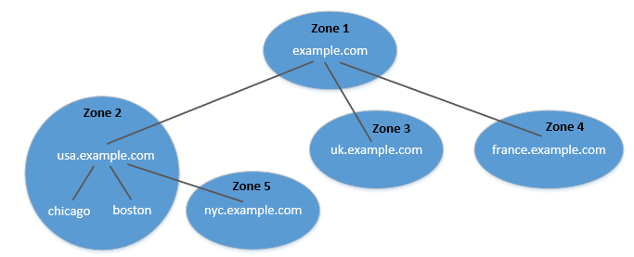
COMPUTER NETWORKS
DNS Zone vs Domain
DNS is organized according to zones.
A zone groups contiguous domains and subdomains on the domain tree.
Assign management authority to an entity.
The tree structure depicts subdomains within example.com domain.
Multiple DNS zones one for each country. The zone keeps records of who the authority is for each of its subdomains.
The zone for example.com contains only the DNS records for the hostnames that do not belong to any subdomain like mail.example.com

Slide 8
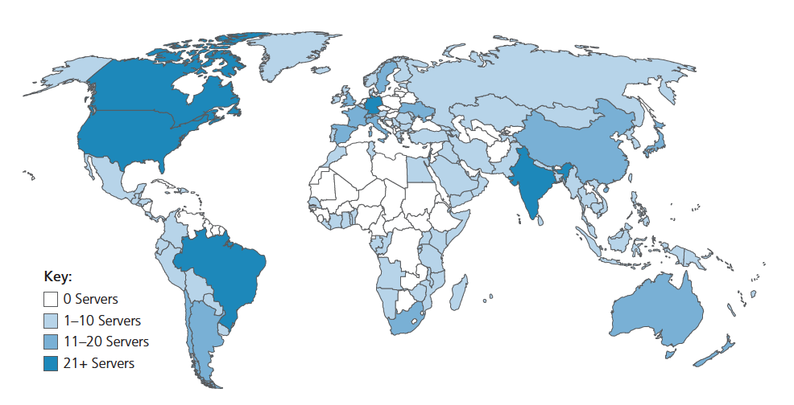
COMPUTER NETWORKS
DNS: root name servers
official, contact-of-last-resort by name servers that can not resolve name
incredibly important Internet function
Internet couldn’t function without it!
DNSSEC – provides security (authentication and message integrity)
ICANN (Internet Corporation for Assigned Names and Numbers) manages root DNS domain
13 logical root name “servers” worldwide each “server” replicated many times (~200 servers in US)

Slide 9
COMPUTER NETWORKS
TLD: authoritative servers
Top-Level Domain (TLD) servers:
responsible for .com, .org, .net, .edu, .aero, .jobs, .museums, and all top-level country domains, e.g.: .cn, .uk, .fr, .ca, .jp
Network Solutions: authoritative registry for .com, .net TLD
Educause: .edu TLD
Authoritative DNS servers:
organization’s own DNS server(s), providing authoritative hostname to IP mappings for organization’s named hosts
can be maintained by organization or service provider

Slide 10
COMPUTER NETWORKS
Local DNS Name Servers
does not strictly belong to hierarchy
each ISP (residential ISP, company, university) has one
also called “default name server”
when host makes DNS query, query is sent to its local DNS server
has local cache of recent name-to-address translation pairs (but may be out of date!)
acts as proxy, forwards query into hierarchy

Slide 11

COMPUTER NETWORKS
DNS name resolution: iterated query
Example: host at engineering.nyu.edu wants IP address for gaia.cs.umass.edu
root DNS server
2
3
TLD DNS server
Iterated query:
contacted server replies with name of server to contact
“I don’t know this name, but ask this server”
1
4
8
5
requesting host at
engineering.nyu.edu
local DNS server
dns.nyu.edu
gaia.cs.umass.edu
7
6
authoritative DNS server
dns.cs.umass.edu

Slide 12
COMPUTER NETWORKS
DNS name resolution: recursive query
Example: host at engineering.nyu.edu wants IP address for gaia.cs.umass.edu
root DNS server
2
3
7
6
Recursive query:
puts burden of name resolution on contacted name server
heavy load at upper levels of hierarchy?
1
TLD DNS server
8
requesting host at
engineering.nyu.edu
local DNS server
dns.nyu.edu
5
4
gaia.cs.umass.edu
authoritative DNS server
dns.cs.umass.edu

Slide 13
COMPUTER NETWORKS
Caching and Updating DNS Records
Suppose that a host apricot.nyu.edu queries dns.nyu.edu for the IP address for the hostname cnn.com. After an hour later, another NYU host, say, kiwi.nyu.edu, also queries dns.nyu.edu.
once (any) name server learns mapping, it caches mapping
cache entries timeout (disappear) after some time (TTL)
TLD servers typically cached in local name servers
thus root name servers not often visited
cached entries may be out-of-date (best-effort name-to-address translation!)
if name host changes IP address, may not be known Internet-wide until all TTLs expire!
update/notify mechanisms proposed IETF standard
RFC 2136

Slide 14
COMPUTER NETWORKS
DNS Records
DNS: distributed database storing resource records (RR)
RR format: (name, value, type, ttl)
type=A
name is hostname
value is IP address
type=CNAME
name is alias name for some “canonical” (the real) name
www.ibm.com is really servereast.backup2.ibm.com
value is canonical name
relayl.bar.foo.com, 145.37.93.126, A
ibm.com, servereast.backup2.ibm.com, CNAME
type=NS
name is domain (e.g., foo.com)
value is hostname of authoritative name server for this domain
type=MX
value is canonical name of a mailserver associated with alias hostname name
foo.com, dns.foo.com, NS
example.com, mail.example.com, MX

Slide 15
COMPUTER NETWORKS
DNS Protocol Messages
DNS query and reply messages, both have same format:
2 bytes
2 bytes
message header:
identification: 16 bit # for query, reply to query uses same #
flags:
query or reply (1-bit)
recursion desired
recursion available
reply is authoritative
identification
flags
# questions
# answer RRs
12 bytes
# authority RRs
# additional RRs
questions (variable # of questions)
Name, type fields for
a query
answers (variable # of RRs)
RRs in response to query
authority (variable # of RRs)
Records for
authoritative servers
additional info (variable # of RRs)
Additional “helpful”
info that may be used

Slide 16
COMPUTER NETWORKS
DNS Protocol Messages
DNS query and reply messages, both have same format:
2 bytes
2 bytes
identification
flags
# questions
# answer RRs
# authority RRs
# additional RRs
name, type fields for a query
questions (variable # of questions)
Type (for example, A, NS, CNAME, and MX), the Value, and the TTL.
RRs in response to query
answers (variable # of RRs)
records for authoritative servers
authority (variable # of RRs)
additional “ helpful” info that may be used
additional info (variable # of RRs)

Slide 17
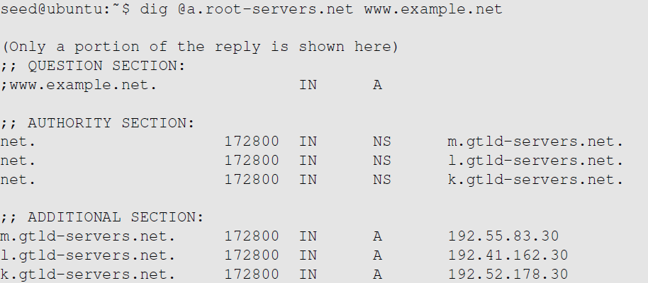
COMPUTER NETWORKS
Emulating Local DNS Server (Step 1: Ask Root)
Directly send the query to this server.
No answer (the root does not know the answer)
Go ask them!

Slide 18
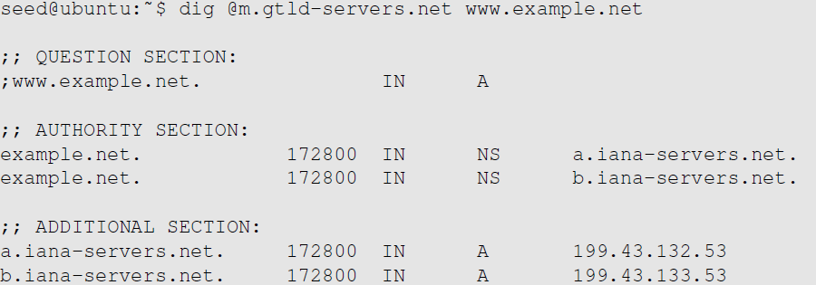
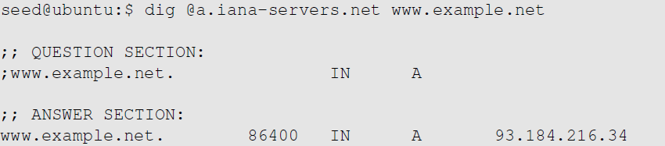
COMPUTER NETWORKS
Steps 2-3: Ask .net & example.net servers
Go ask them!
Ask an example.net nameservers.
Finally got the answer

Slide 19
COMPUTER NETWORKS
Inserting records into DNS
Example: new startup “Network Utopia”
register name networkuptopia.com at DNS registrar (e.g., Network Solutions)
provide names, IP addresses of authoritative name server (primary and secondary)
registrar inserts NS, A RRs into .com TLD server:
(networkutopia.com, dns1.networkutopia.com, NS)
(dns1.networkutopia.com, 212.212.212.1, A)
create authoritative server locally with IP address 212.212.212.1
type A record for www.networkuptopia.com
type MX record for networkutopia.com

Slide 20
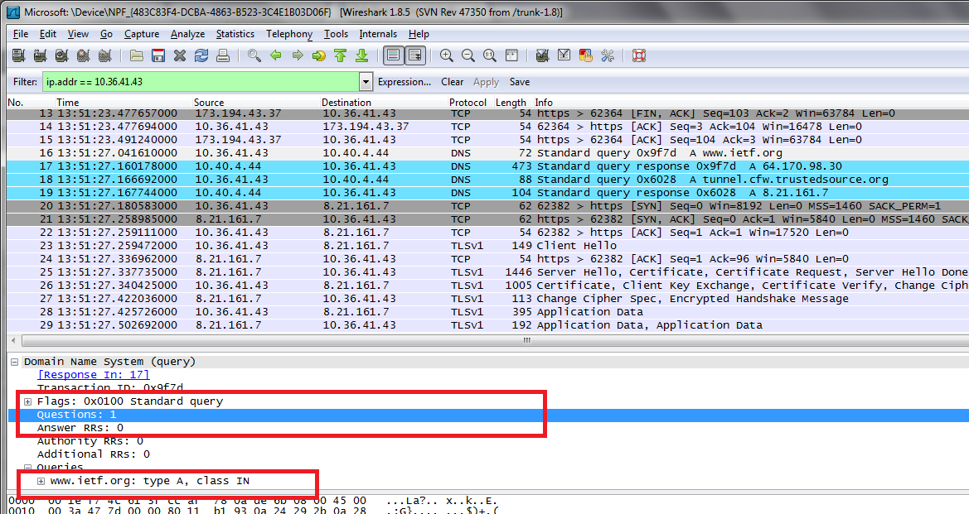
COMPUTER NETWORKS
DNS Request - Wireshark Packet Capture

Slide 21
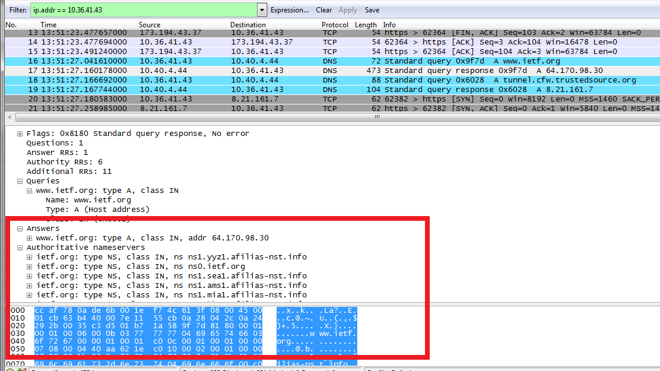
COMPUTER NETWORKS
DNS Response - Wireshark Packet Capture

Slide 22

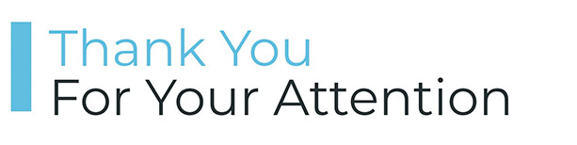
COMPUTER NETWORKS
Suggested Readings
DNS (Domain Name System) – Explained – https://youtu.be/JkEYOt08-rU
How a DNS Server (Domain Name System) works – https://youtu.be/rdVPflECed8
Wireshark Lab: DNS v7.0 – http://www-net.cs.umass.edu/wireshark-labs/Wireshark_DNS_v7.0.pdf

Slide 23




COMPUTER NETWORKS
Unit – 2 Application Layer
2.3 The Domain Name System
2.4 P2P Applications
2.5 Socket Programming with TCP & UDP
2.6 Other Application Layer Protocols

Slide 24








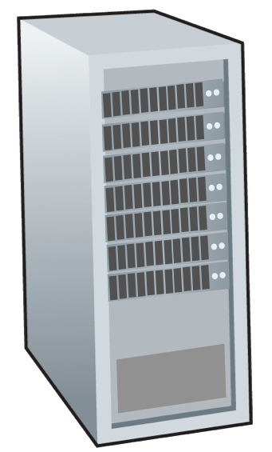







COMPUTER NETWORKS
Peer-to-peer (P2P) architecture
no always-on server
arbitrary end systems directly communicate
peers request service from other peers, provide service in return to other peers
self scalability – new peers bring new service capacity, and new service demands
peers are intermittently connected and change IP addresses
complex management
examples: P2P file sharing (BitTorrent), media streaming (Spotify), VoIP (Skype)
mobile network
national or global ISP
local or regional ISP
home network
content
provider
network
datacenter
network
enterprise
network

Slide 25
COMPUTER NETWORKS
File distribution: client-server vs P2P
Q: how much time to distribute file (size F) from one server to N peers?
peer upload/download capacity is limited resource
The distribution time is the time it takes to get a copy of the file to all N peers.
u_{s}: server upload capacity
d_{i}: peer i download capacity
file, size F
u₁
d₁
u₂
u_{s}
d₂
server
d_{i}
u_{N}
network (with abundant
bandwidth)
u_{i}
d_{N}
u_{i}: peer i upload capacity

Slide 26
COMPUTER NETWORKS
File distribution time: client-server
server transmission: must sequentially send (upload) N file copies:
time to send one copy: F/u_{s}
time to send N copies: NF/u_{s}
F
u_{s}
d_{i}
network
client: each client must download file copy
d_{min} = min client download rate =
i.e., d_{min} = min {d1, dp,……, dN }
min client download time: F/d_{min}
u_{i}
time to distribute F
to N clients using
client-server approach
D_{c-s} > max{NF/u_{s,},F/d_{min}}
increases linearly in N

Slide 27
COMPUTER NETWORKS
File distribution time: P2P
server transmission: must upload at least one copy:
time to send one copy: F/u_{s}
F
u_{s}
d_{i}
client: each client must download file copy
min client download time: F/d_{min}
network
u_{i}
Eqtn - provides a lower bound for the minimum distribution time for the P2P
architecture.
clients: as aggregate must download NF bits
max upload rate (limiting max download rate) is u_{s} + Σu_{i}
Total upload capacity of the system as a whole
time to distribute F
to N clients using
P2P approach
D_{P2P} > max{F/u_{s},F/d_{min},NF/(u_{s} + Σu_{i})}
increases linearly in N …
… but so does this, as each peer brings service capacity

Slide 28
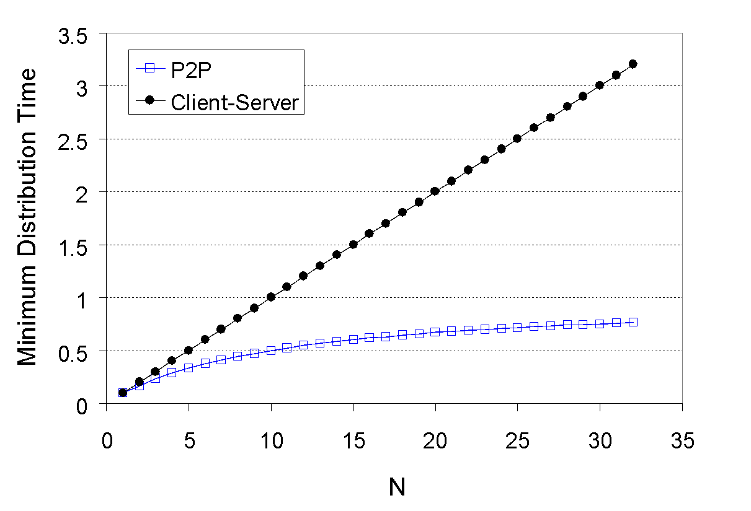
COMPUTER NETWORKS
Client-server vs. P2P: example
Client (all peers) upload rate = u, F/u = 1 hour, u_{s} = 10u, d_{min} ≥ u_{s}
A peer can transmit the entire file in one hour.
The server transmission rate is 10 times the peer upload rate.
Peer download rates are set large enough so as not to have an effect.

Slide 29


COMPUTER NETWORKS
P2P file distribution: BitTorrent
file divided into 256Kb chunks
peers in torrent send/receive file chunks
tracker: tracks peers
participating in torrent
torrent: group of peers exchanging chunks of a file
Alice arrives …
… obtains list
of peers from tracker
… and begins exchanging
file chunks with peers in torrent

Slide 30


COMPUTER NETWORKS
P2P file distribution: BitTorrent
peer joining torrent:
has no chunks, but will accumulate them over time from other peers
registers with tracker to get list of peers, connects to subset of peers (“neighbors”)
while downloading, peer uploads chunks to other peers
peer may change peers with whom it exchanges chunks
churn: peers may come and go
once peer has entire file, it may (selfishly) leave or (altruistically) remain in torrent

Slide 31
COMPUTER NETWORKS
BitTorrent: requesting, sending file chunks
Requesting chunks:
at any given time, different peers have different subsets of file chunks
periodically, Alice asks each peer for list of chunks that they have
Alice requests missing chunks from peers, rarest first
Sending chunks: tit-for-tat
Alice sends chunks to those four peers currently sending her chunks at highest rate
other peers are choked by Alice (do not receive chunks from her)
re-evaluate top 4 every 10 secs
every 30 secs: randomly select another peer, starts sending chunks
“optimistically unchoke” this peer
newly chosen peer may join top 4

Slide 32

COMPUTER NETWORKS
BitTorrent: tit-for-tat
(1) Alice “optimistically unchokes” Bob
(2) Alice becomes one of Bob’s top-four providers; Bob reciprocates
(3) Bob becomes one of Alice’s top-four providers
Pieces (mini-chunks), pipelining, random first selection, endgame mode, and anti-snubbing
higher upload rate: find better trading partners, get file faster !

Slide 33
COMPUTER NETWORKS
Suggested Readings
BitTorrent (BTT) White Paper – https://www.bittorrent.com/btt/btt-docs/BitTorrent_(BTT)_White_Paper_v0.8.7_Feb_2019.pdf
Peer-to-peer networking with BitTorrent – http://web.cs.ucla.edu/classes/cs217/05BitTorrent.pdf
Torrents Explained: How BitTorrent Works – https://youtu.be/urzQeD7ftbI

Slide 34
COMPUTER NETWORKS
Unit – 2 Application Layer
2.3 The Domain Name System
2.4 P2P Applications
2.5 Socket Programming with TCP & UDP
2.6 Other Application Layer Protocols

Slide 35
COMPUTER NETWORKS
Socket Programming
goal: learn how to build client/server applications that communicate using sockets
socket: door between application process and end-end-transport protocol
application
socket
application
controlled by
app developer
process
process
transport
transport
network
network
controlled
by OS
link
Internet
link
physical
physical

Slide 36
COMPUTER NETWORKS
Socket Programming
Two socket types for two transport services:
UDP: unreliable datagram
TCP: reliable, byte stream-oriented
Application Example:
client reads a line of characters (data) from its keyboard and sends data to server
server receives the data and converts characters to uppercase
server sends modified data to client
client receives modified data and displays line on its screen

Slide 37
COMPUTER NETWORKS
Socket Programming with UDP
UDP: no “connection” between client & server
no handshaking before sending data
sender explicitly attaches IP destination address and port # to each packet
receiver extracts sender IP address and port# from received packet
UDP: transmitted data may be lost or received out-of-order
Application viewpoint:
UDP provides unreliable transfer of groups of bytes (“datagrams”) between client and server

Slide 38
COMPUTER NETWORKS
Client/Server socket interaction: UDP
server (running on serverIP)
client
create socket:
create socket, port= x:
clientSocket =
socket(AF_INET,SOCK_DGRAM)
serverSocket =
socket(AF_INET,SOCK_DGRAM)
Create datagram with server IP and
port=x; send datagram via clientSocket
read datagram from
serverSocket
write reply to
serverSocket
specifying client address,
port number
read datagram from
clientSocket
close
clientSocket

Slide 39
COMPUTER NETWORKS
Example app: UDP client
Python UDPClient
include Python’s socket library
from socket import *
serverName = ‘hostname’
serverPort = 12000
clientSocket = socket(AF_INET,
SOCK_DGRAM)
message = raw_input(’Input lowercase sentence:’)
clientSocket.sendto(message.encode(),
(serverName, serverPort))
modifiedMessage, serverAddress =
clientSocket.recvfrom(2048)
print modifiedMessage.decode()
clientSocket.close()
create UDP socket for server
get user keyboard input
attach server name, port to message; send into socket
read reply characters from socket into string
print out received string and close socket

Slide 40
COMPUTER NETWORKS
Example app: UDP server
Python UDPServer
from socket import *
serverPort = 12000
serverSocket = socket(AF_INET, SOCK_DGRAM)
serverSocket.bind(('', serverPort))
print (“The server is ready to receive”)
while True:
message, clientAddress = serverSocket.recvfrom(2048)
modifiedMessage = message.decode().upper()
serverSocket.sendto(modifiedMessage.encode(),
clientAddress)
create UDP socket
bind socket to local port number 12000
loop forever
Read from UDP socket into message, getting client’s address (client IP and port)
send upper case string back to this client

Slide 41
COMPUTER NETWORKS
Socket programming with TCP
Client must contact server
server process must first be running
server must have created socket (door) that welcomes client’s contact
Client contacts server by:
Creating TCP socket, specifying IP address, port number of server process
when client creates socket: client TCP establishes connection to server TCP
when contacted by client, server TCP creates new socket for server process to communicate with that particular client
allows server to talk with multiple clients
source port numbers used to distinguish clients (more in Chap 3)
Application viewpoint
TCP provides reliable, in-order
byte-stream transfer (“pipe”)
between client and server

Slide 42
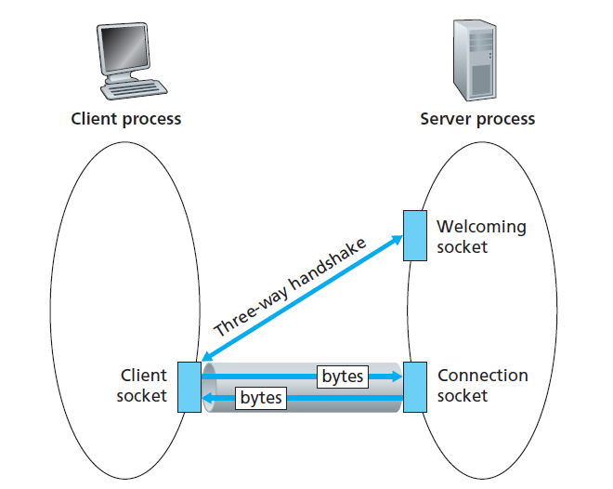
COMPUTER NETWORKS
The TCPServer Process has Two Sockets

Slide 43
COMPUTER NETWORKS
Client/server socket interaction: TCP
server (running on hostid)
client
create socket,
port=x, for incoming request:
serverSocket = socket()
wait for incoming
connection request
TCP
connection setup
create socket,
connect to hostid, port=x
connectionSocket =
serverSocket.accept()
clientSocket = socket()
send request using
clientSocket
read request from
connectionSocket
write reply to
connectionSocket
read reply from
clientSocket
close
connectionSocket
close
clientSocket

Slide 44
COMPUTER NETWORKS
Example app: TCP client
Python TCPClient
from socket import *
serverName = ’servername’
serverPort = 12000
clientSocket = socket(AF_INET, SOCK_STREAM)
clientSocket.connect((serverName,serverPort))
sentence = raw_input(‘Input lowercase sentence:’)
clientSocket.send(sentence.encode())
modifiedSentence = clientSocket.recv(1024)
print (‘From Server:’, modifiedSentence.decode())
clientSocket.close()
create TCP socket for server, remote port 12000
No need to attach server name, port

Slide 45
COMPUTER NETWORKS
Example app: TCP server
Python TCPServer
from socket import *
serverPort = 12000
serverSocket = socket(AF_INET,SOCK_STREAM)
serverSocket.bind((‘’,serverPort))
serverSocket.listen(1)
print ‘The server is ready to receive’
while True:
connectionSocket, addr = serverSocket.accept()
sentence = connectionSocket.recv(1024).decode()
capitalizedSentence = sentence.upper()
connectionSocket.send(capitalizedSentence.
encode())
connectionSocket.close()
create TCP welcoming socket
server begins listening for incoming TCP requests
loop forever
server waits on accept() for incoming requests, new socket created on return
read bytes from socket (but not address as in UDP)
close connection to this client (but not welcoming socket)

Slide 46
COMPUTER NETWORKS
Unit – 2 Application Layer
2.3 The Domain Name System
2.4 P2P Applications
2.5 Socket Programming with TCP & UDP
2.6 Other Application Layer Protocols

Slide 47
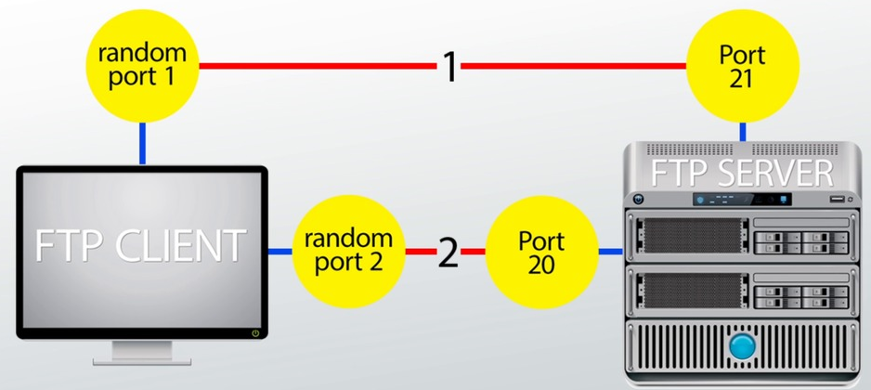
COMPUTER NETWORKS
Other Application Layer Protocols - FTP
File Transfer Protocol (FTP) - used to exchange large files on the internet TCP
Invoked from the command prompt or some GUI.
Allows to update (delete, rename, move, and copy) files at a server.
Data connection (Port No. 20) & Control connection (Port No. 21)

Slide 48
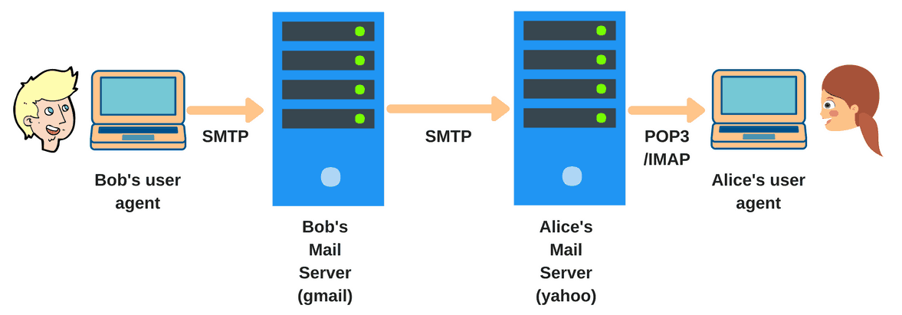
COMPUTER NETWORKS
Other Application Layer Protocols - SMTP
Simple Mail Transfer Protocol - an internet standard for e-mail Transmission.
Connections are secured with SSL (Secure Socket Layer).
Messages are stored and then forwarded to the destination (relay).
SMTP uses a port number 25 of TCP.

Slide 49
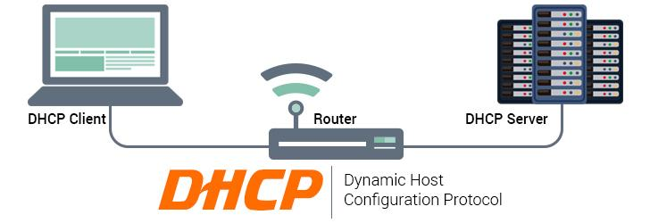
COMPUTER NETWORKS
Other Application Layer Protocols - DHCP
Dynamic Host Configuration Protocol - assign IP addresses to computers in a network dynamically.
IP addresses may change even when computer is in network (DHCP leases).
DHCP port number for server is 67 and for the client is 68.
A client-server model & based on discovery, offer, request, and ACK.
Includes subnet mask, DNS server address, default gateway

Slide 50
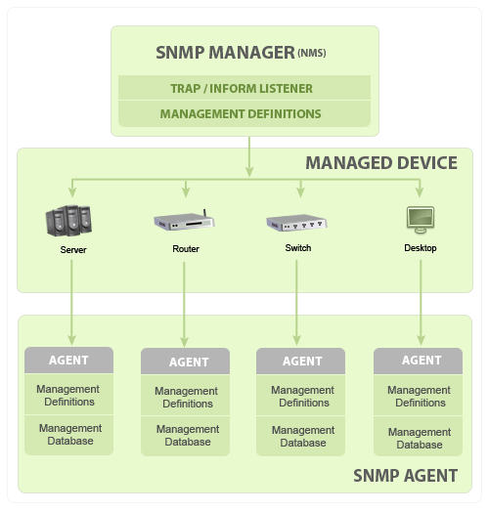
COMPUTER NETWORKS
Other Application Layer Protocols - SNMP
Simple Network Management Protocol - exchange management information between network devices.
Basic components & functionalities
SNMP Manager
Managed Devices
SNMP Agents
MIB (Management Information Base)

Slide 51
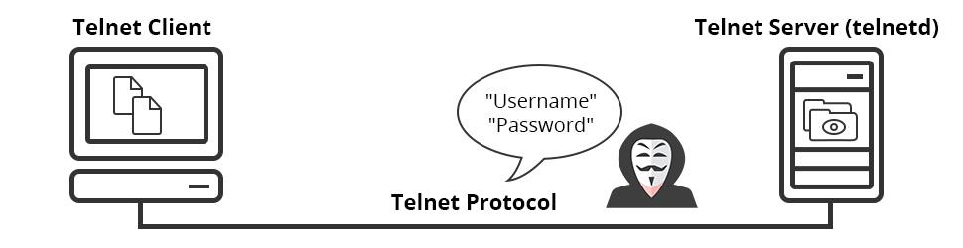
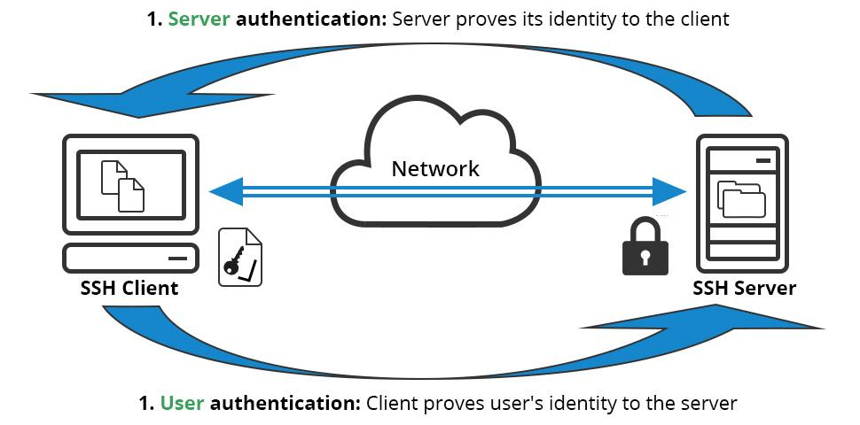
COMPUTER NETWORKS
Other Application Layer Protocols – Telnet & SSH
Allows a user to communicate with a remote device.
Used mostly by network admin to remotely access and manage devices.
Telnet client and server installed – uses TCP port no. 23
SSH – uses public key encryption & TCP port 22 by default.

Slide 52
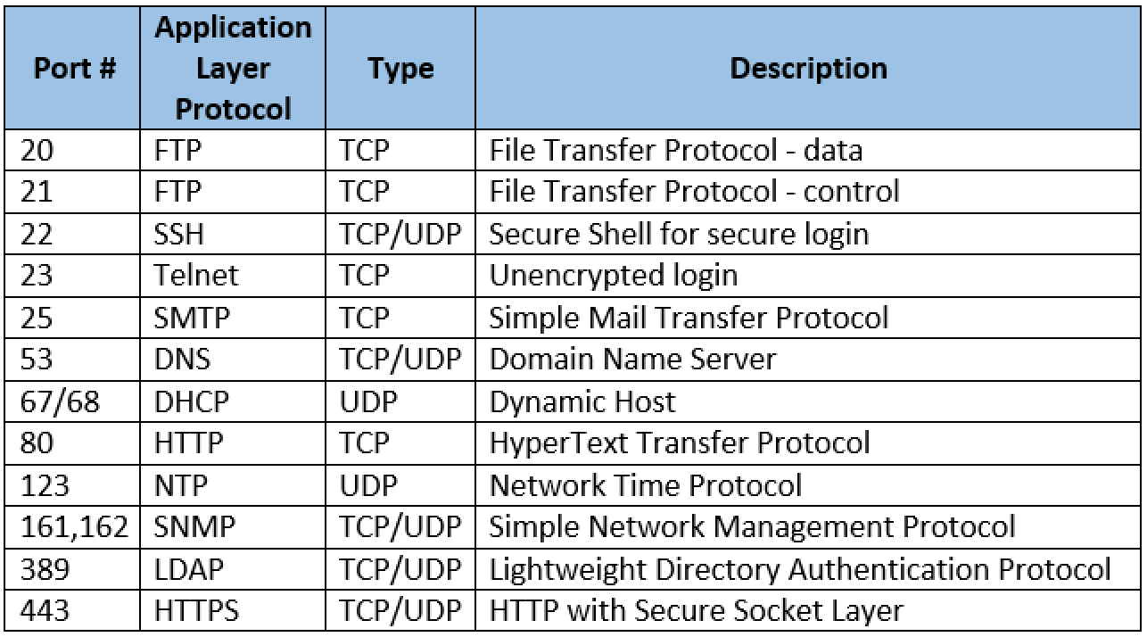
COMPUTER NETWORKS
Summary of Application Layer Protocols

Slide 53
COMPUTER NETWORKS
Summary
our study of network application layer is now complete!
application architectures
client-server
P2P
application service requirements:
reliability, bandwidth, delay
Internet transport service model
connection-oriented, reliable: TCP
unreliable, datagrams: UDP
specific protocols:
HTTP
DNS
P2P: BitTorrent
socket programming:
TCP, UDP sockets

Slide 54
COMPUTER NETWORKS
Summary (more)
Most importantly: learned about protocols!
typical request/reply message exchange:
client requests info or service
server responds with data, status code
message formats:
headers: fields giving info about data
data: info(payload) being communicated
important themes:
centralized vs. decentralized
stateless vs. stateful
scalability
reliable vs. unreliable message transfer
“complexity at network edge”

Slide 55
THANK YOU
TEAM NETWORKS
Department of Computer Science and Engineering

